Slide 1
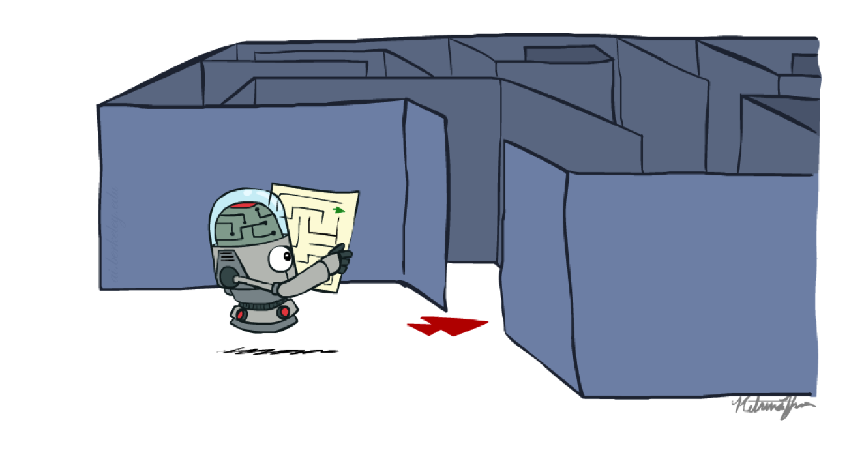
Artificial Intelligence
Search
Yang Xu
PALM
Notes:
Please retain proper attribution, including the reference to ai.berkeley.edu. Thanks!

Slide 2
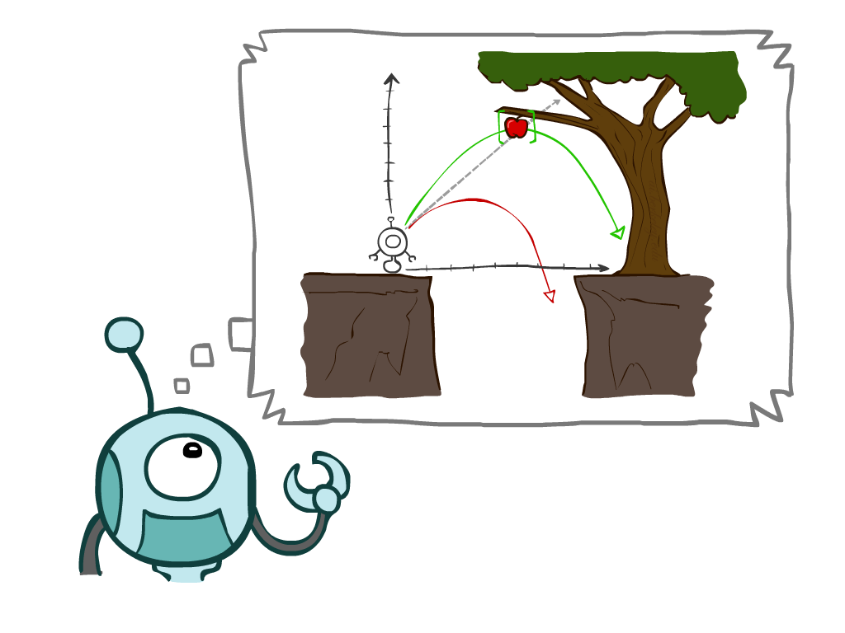
Today
搜索问题
无信息搜索
深度优先搜索
宽度优先搜索
均匀损失搜索
Notes:
General theme in the class:
A goal we have in mind.
A mathematical abstraction to formalize this
Algorithms that operate on these abstractions

Slide 3

Search Problems

Slide 4

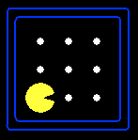





Search Problems
搜索问题的组成要素:
状态空间
后继函数(包含动作和代价)
初始状态与目标检测
解 ：指一组动作序列（即规划），能够将初始状态转化为目标状态。
“N”, 1.0
“E”, 1.0
Notes:
Often comes back on exams
Goal test – sometimes more than one state that satisfies having achieved the goal, for example, “eat all the dots”
Abstraction

Slide 5
Example: Traveling in Romania
状态空间:
城市节点
后继函数:
道路连接：移动至相邻城市，其代价cost等于道路距离
初始状态:
Arad
目标检测:
当前状态 == Bucharest?
解?

Slide 6
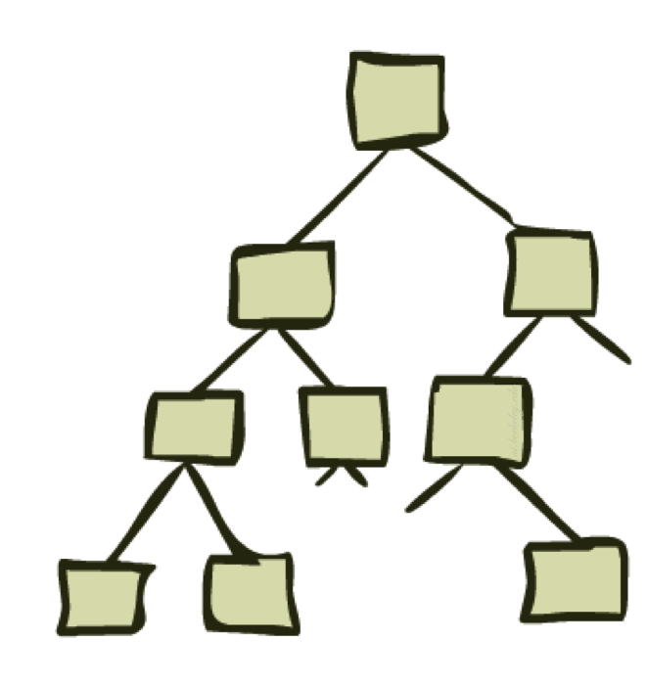
State Space Graphs and Search Trees

Slide 7
State Space Graphs
状态空间图: 搜索问题的数学化表示
节点是（抽象化的）配置
弧 (Arcs)代表后继函数（即执行动作后的状态结果）
目标检测是由一个或多个目标节点组成的集合
在状态空间图中，每个状态仅出现一次！
由于规模过大，我们极少能在内存中完整构建该图，但它是一个极具价值的理论模型。

Slide 8
Search Trees
这是现在 / 初始状态
“N”, 1.0
“E”, 1.0
可能的结果
搜索树:
初始状态即为根节点
子节点对应其后继状态
节点显示的是状态，但对应的是达成这些状态的规划
这是一个关于规划及其结果的 “假设 (What if)” 树
对于大多数问题，我们永远无法真正构建出整棵树
Notes:
Different plans that achieve the same state, will be different nodes in the tree.
在state space graph中，每个state只出现一次，在search tree中，每个state可以变为不同的nodes，这些nodes可由不同的plan到达。

Slide 9
State Space Graphs vs. Search Trees
状态空间图
搜索树中的每个节点 (NODE) 都对应状态空间图中的一条完整路径
搜索树
S
a
G
d
e
p
b
c
q
b
c
e
h
r
d
e
f
a
a
h
r
p
q
f
S
h
我们按需构建这两者——并且尽可能少地进行构建
p
q
f
q
c
G
p
q
r
q
c
G
a
a
Notes:
It is important to understand the distinction between the state space and the search tree.
The state space describes the (possibly infinite) set of states in the world, and the actions
that allow transitions from one state to another. The search tree describes paths between
these states, reaching towards the goal. The search tree may have multiple paths to (and thus
multiple nodes for) any given state, but each node in the tree has a unique path back to the
root (as in all trees).

Slide 10

Quiz: State Space Graphs vs. Search Trees
考虑这个包含 4 个状态的图：
其搜索树（从 S 开始）有多大？
a
S
G
b
重要提示：搜索树中存在大量重复结构！

Slide 11
Tree Search

Slide 12
Search Example: Romania

Slide 13
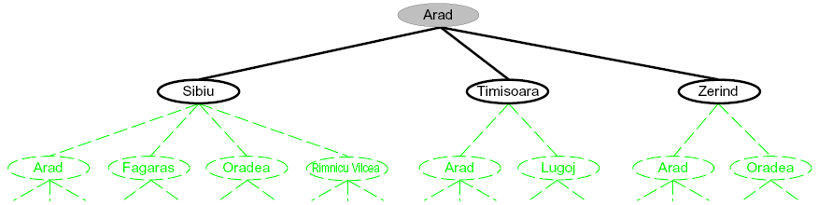
Searching with a Search Tree
搜索:
展开潜在规划（即树节点）
维护边缘集 ：包含正在考虑中的部分规划

Slide 14
General Tree Search
核心概念:
边缘集
节点展开
搜索策略
核心问题：该探索哪些边缘节点？

Slide 15
Uninformed search strategies
盲目搜索策略仅使用问题定义中提供的信息
广度优先搜索
深度优先搜索
深度受限搜索
迭代加深搜索

Slide 16
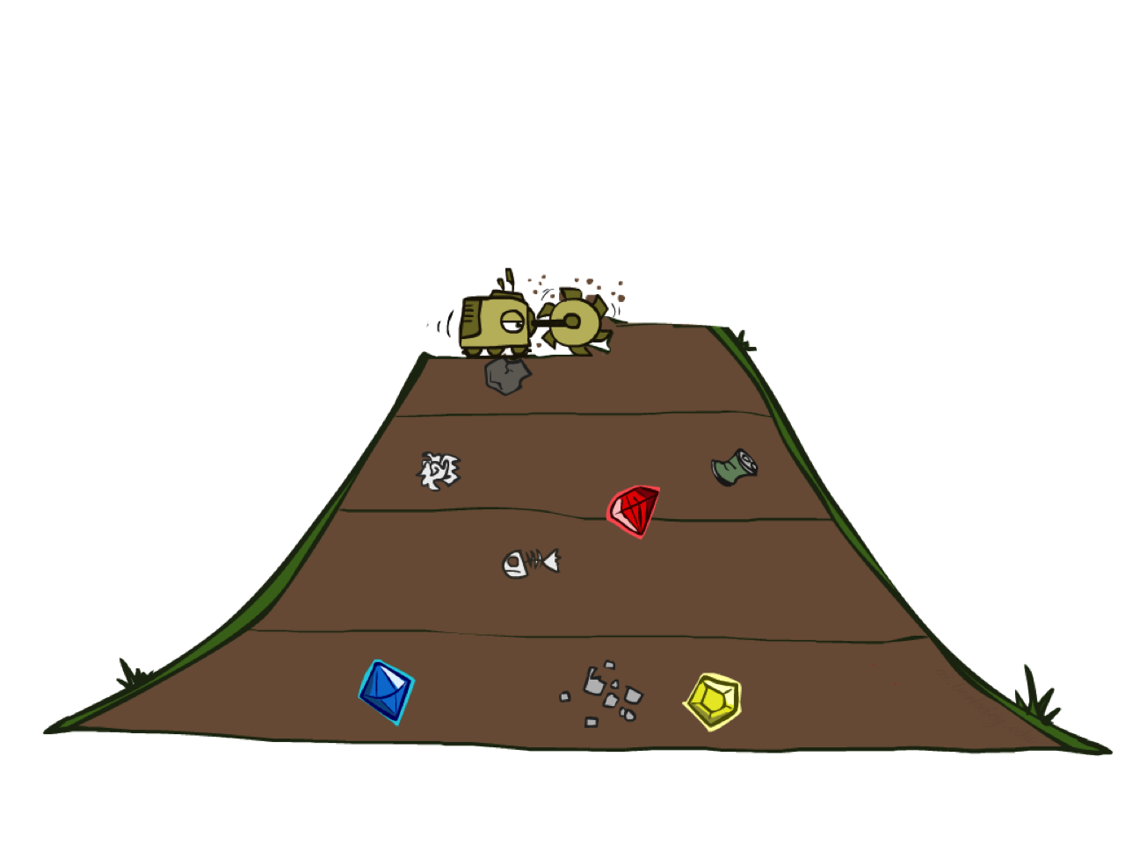
Breadth-First Search

Slide 17
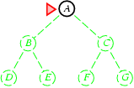
Breadth-first search
Expand shallowest unexpanded node
Implementation:
Frontier or fringe is a FIFO queue, i.e., new successors go at end
FIFO: first in first out
A

Slide 18
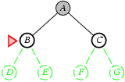
Breadth-first search
Expand shallowest unexpanded node
Implementation:
Frontier or fringe is a FIFO queue, i.e., new successors go at end
C
B

Slide 19
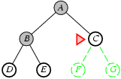
Breadth-first search
Expand shallowest unexpanded node
Implementation:
Frontier or fringe is a FIFO queue, i.e., new successors go at end
E
D
C

Slide 20
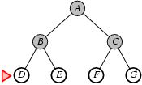
Breadth-first search
Expand shallowest unexpanded node Implementation:
Frontier or fringe is a FIFO queue, i.e., new successors go at end
G
F
E
D

Slide 21
Breadth-First Search
Strategy: expand a shallowest node first
Implementation: Fringe is a FIFO queue
a
G
b
c
d
e
f
S
h
p
q
r
S
d
e
p
Search
Tiers
b
c
e
h
r
q
a
a
h
r
p
q
f
p
q
f
q
c
G
q
c
G
a
a
Notes:
这里我们再看一个复杂点的例子

Slide 22
Search strategies
A search strategy is defined by picking the order of node expansion
Strategies are evaluated along the following dimensions:
completeness: does it always find a solution if one exists?
time complexity: number of nodes generated
space complexity: maximum number of nodes in memory
optimality: does it always find a least-cost solution?
Time and space complexity are measured in terms of
b: maximum branching factor of the search tree
d: depth of the least-cost solution
m: maximum depth of the state space (may be ∞)
Notes:
Very popular, basically graph theory

Slide 23
Properties of breadth-first search
Complete? Time? Space?Optimal?
Complete? Yes (if b is finite)
Time? 1+b+b²+b³+… +b^{d} = O(b^{d})
Space? O(b^{d}) (keeps every node in memory)
Optimal? Yes (if cost = 1 per step)
Space is the bigger problem (more than time)
Notes:
We skip for now, come back later.

Slide 24
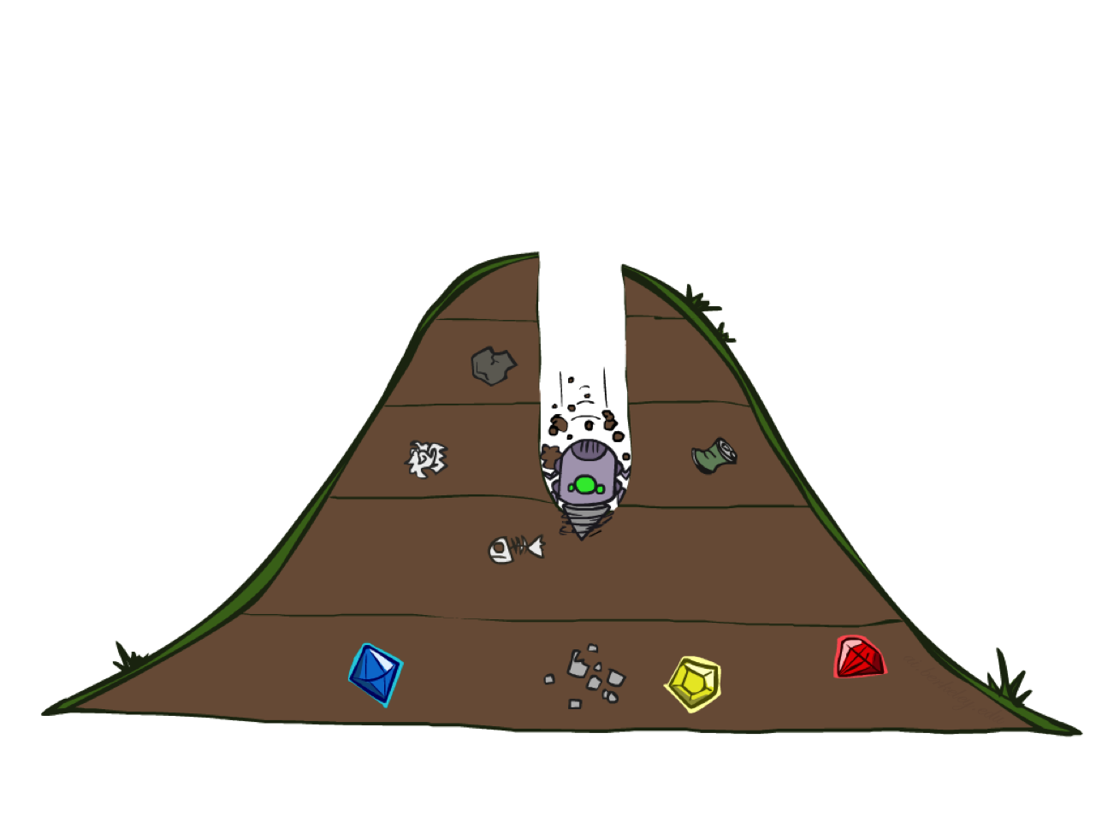
Depth-First Search

Slide 25
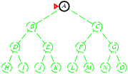
Depth-first search
Expand deepest unexpanded node
Implementation:
frontier = LIFO queue, i.e., put successors at front
A

Slide 26
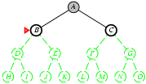
Depth-first search
Expand deepest unexpanded node
Implementation:
frontier = LIFO queue, i.e., put successors at front
B
A

Slide 27
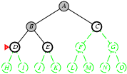
Depth-first search
Expand deepest unexpanded node
Implementation:
frontier = LIFO queue, i.e., put successors at front
D
B
A

Slide 28
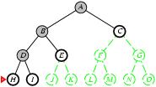
Depth-first search
Expand deepest unexpanded node
Implementation:
frontier = LIFO queue, i.e., put successors at front
H
D
B
A

Slide 29
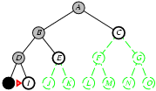
Depth-first search
Expand deepest unexpanded node
Implementation:
frontier = LIFO queue, i.e., put successors at front
I
D
B
A

Slide 30
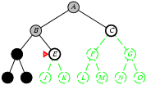
Depth-first search
Expand deepest unexpanded node
Implementation:
frontier = LIFO queue, i.e., put successors at front
E
B
A

Slide 31
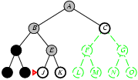
Depth-first search
Expand deepest unexpanded node
Implementation:
frontier = LIFO queue, i.e., put successors at front
J
E
B
A

Slide 32
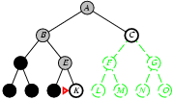
Depth-first search
Expand deepest unexpanded node
Implementation:
frontier = LIFO queue, i.e., put successors at front
K
E
B
A

Slide 33
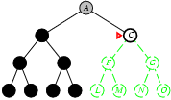
Depth-first search
Expand deepest unexpanded node
Implementation:
frontier = LIFO queue, i.e., put successors at front
C
A

Slide 34
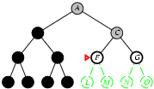
Depth-first search
Expand deepest unexpanded node
Implementation:
frontier = LIFO queue, i.e., put successors at front
F
C
A

Slide 35
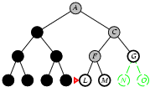
Depth-first search
Expand deepest unexpanded node
Implementation:
frontier = LIFO queue, i.e., put successors at front
L
F
C
A

Slide 36
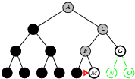
Depth-first search
Expand deepest unexpanded node
Implementation:
frontier = LIFO queue, i.e., put successors at front
M
F
C
A

Slide 37
Depth-First Search
a
G
Strategy: expand a deepest node first
Implementation: Fringe is a LIFO stack
a
c
b
c
b
e
d
e
d
f
f
S
h
h
p
p
r
q
r
q
S
d
e
p
b
c
e
h
r
q
a
a
h
r
p
q
f
p
q
f
q
c
G
q
c
G
a
a
Notes:
这里再看一个复杂点的例子

Slide 38
Properties of depth-first search
Complete? Time? Space?Optimal?
Complete? No: fails in infinite-depth spaces, spaces with loops
Modify to avoid repeated states along path (graph search)
→ complete in finite spaces
Time? O(b^{m}): terrible if maximum depth m is much larger than solution depth d
but if solutions are dense, may be much faster than breadth-first
Space? O(bm), i.e., linear space! Store single path with unexpanded siblings.
Seems to be common in animals and humans.
Optimal? No.
Important for exploration (on-line search).

Slide 39
Depth-limited search
depth-first search with depth limit l,
i.e., nodes at depth l have no successors
Solves infinite loop problem
Common AI strategy: let user choose search/resource bound. Complete? No if l < d:
Time? O(b^{l}):
Space? O(bl), i.e., linear space!
Optimal? No if l > b
Notes:
如果最优解的深度太深了，那么要的时间就非常长，所以要限定depth

Slide 40
Iterative Deepening
Idea: get DFS’s space advantage with BFS’s time / shallow-solution advantages
Run a DFS with depth limit 1. If no solution…
Run a DFS with depth limit 2. If no solution…
Run a DFS with depth limit 3. …..
Isn’t that wastefully redundant?
Generally most work happens in the lowest level searched, so not so bad!
b
…
Notes:
如果最优解的深度太深了，那么要的时间就非常长，所以要限定depth
但是不知道多深才够好，所以干脆全部的depth都试一遍

Slide 41
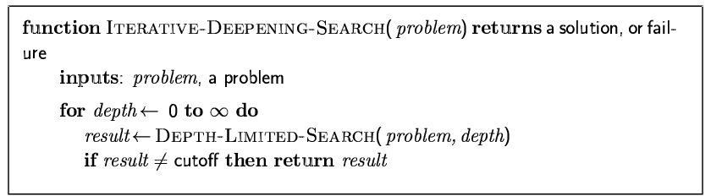
Iterative deepening search

Slide 42
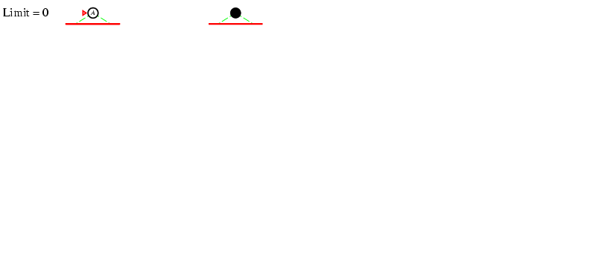
Iterative deepening search l =0

Slide 43
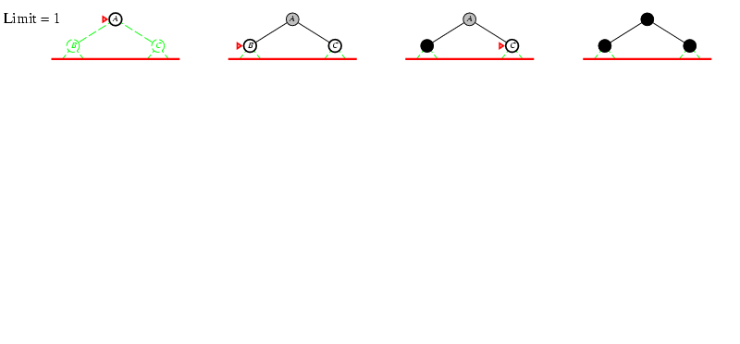
Iterative deepening search l =1

Slide 44
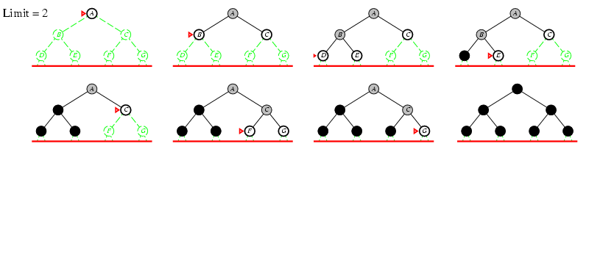
Iterative deepening search l =2

Slide 45
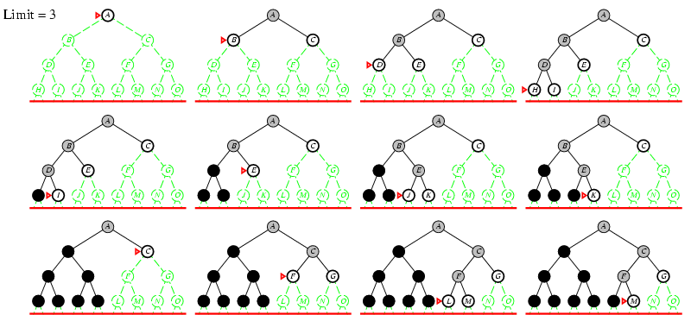
Iterative deepening search l =3
Notes:
http://www.ai.sri.com/~oreilly/aima3ejava/aima3ejavademos.html
Is seriously buggy

Slide 46
Iterative deepening search
Number of nodes generated in a depth-limited search to depth d with branching factor b:
N_{DLS} = b⁰ + b¹ + b² + … + b^{d-2} + b^{d-1} + b^{d}
Number of nodes generated in an iterative deepening search to depth d with branching factor b:
N_{IDS} = (d+1)b⁰ + d b¹ + (d-1)b² + … + 3b^{d-2} +2b^{d-1} + 1b^{d}
For b = 10, d = 5,
N_{DLS} = 1 + 10 + 100 + 1,000 + 10,000 + 100,000 = 111,111
N_{IDS} = 6 + 50 + 400 + 3,000 + 20,000 + 100,000 = 123,456
Notes:
Iterative deepening search may seem wasteful because states near the top of the search
tree are re-generated multiple times. But for many state spaces, most of the nodes are in the
bottom level, so it does not matter much that the upper levels are repeated. In an iterative
deepening search, the nodes on the bottom level (depth d) are generated once, those on the
next-to-bottom level are generated twice, and so on, up to the children of the root, which are
generated d times. So the total number of nodes generated in the worst case is
N(IDS) = (d)b1+(d􀀀1)b2+(d􀀀2)b3 _x0001_ _x0001_ _x0001_+bd ;

Slide 47
Properties of iterative deepening search
Complete? Yes
Time? (d+1)b⁰ + d b¹ + (d-1)b² + … + b^{d} = O(b^{d})
Space? O(bd)
Optimal? Yes, if step cost = 1

Slide 48
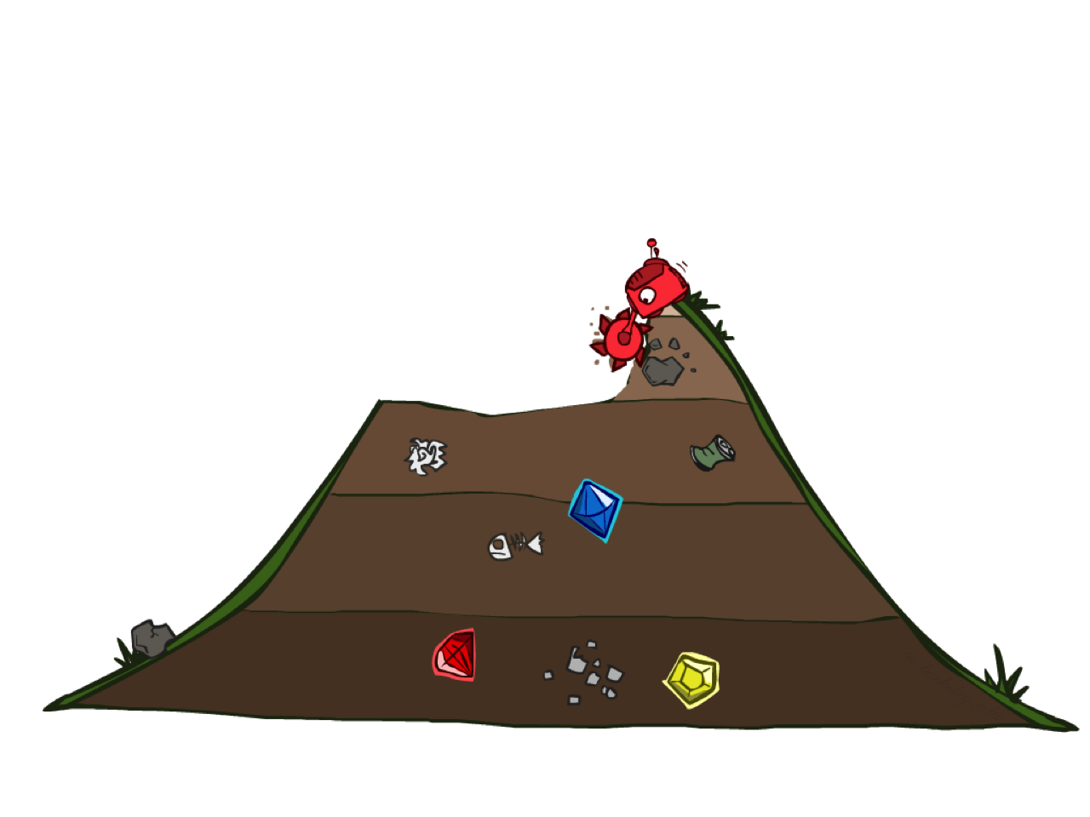
Uniform Cost Search

Slide 49
Uniform Cost Search
2
a
G
Strategy: expand a cheapest node first:
Fringe is a priority queue (priority: cumulative cost)
b
c
1
8
2
2
e
3
d
f
9
8
2
S
h
1
1
p
q
r
15
0
S
d
3
e
9
p
1
b
4
e
5
h
17
r
11
q
16
c
11
Cost contours
a
6
a
h
13
r
7
p
q
f
p
q
f
8
q
c
G
q
c
a
11
G
10
a
Notes:
如果所有的cost都是1，那么ucs和bfs等价

